Slide 1

Value-Based Care: Zoom Session Week 2

Slide 2
Agenda
Quick Background: Mapping case to Unit 4
Case Discussion

Slide 3
Review of Value Definition: (Rough) Mapping
Triple Aim | Diabetes VBC in north central London
Maximize Population Health | Clinical and social outcome measures (CSOM): Objective clinical outcomes and indicators
 | Patient reported outcome measures (PROMs): Patient reports on clinician-defined measures of well being and perceived ability to cope (EQ-5D)
Maximize Patient Experience of Care | Patient-Defined outcome measures (PDOMs): Patient’s view of care benefits
Minimize total per capita costs | (Implicit: Budget constraint)
Case illustrates that value must be clearly defined, operationalized, and accepted within the relevant care context

Slide 4
Review: Incentive Mechanisms
Unit 4 Video | Case
-- | Block Payments | By geography (rather than individual or care episode)
Capitation | Capitation | By individual (can be weighted to reflect risk adjustment)
Bundled payments | PbR | By diagnosis / procedure (care event)
Fee for Service | FFS | By specific procedure
Shared Savings & Process Measures | Pay-for-Performance | Add-on compensation for specific, measured aspects of performance such as cost savings or measured components of care

Slide 5
Why this initiative?

Slide 6
Physician perspective?

Slide 7
Ensure success?
Start with modeling & measurement or start with contracting?

Slide 8
Case Summary
Outcomes
- Overall health
- Integration
Provider Acceptance
-Complexity up
- Controllability down
Process Requirements
- Information (Analytics)
-Coordinated organizations
requires
requires

Slide 9
NHS current diabetes priorities
The importance of improving outcomes for individuals with diabetes is reflected in the inclusion in the CCG Improvement and Assessment Framework (CCG IAF) of indicators covering:
Diabetes patients that have achieved all the NICE recommended treatment targets: Three (HbA1c (blood sugar), cholesterol and blood pressure) for adults and one (HbA1c) for children
People with diabetes diagnosed less than a year who attend a structured education course.
These have been selected because they are recognized evidence-based measures of whether patients with diabetes are being supported to successfully manage their condition.
Notes:
https://www.england.nhs.uk/diabetes/treatment-care/

Slide 10
NHS Jan 2019 long-term plan
General:
Encouraging integrated care
Increasing patient control and personalization
Encouraging out-of-hospital care; coordination between GPs and community health
Diabetes Care:
Structured education and digital self-management tools for patients
Support Primary Care initiatives to achieve diabetes treatment targets
Flash glucose monitors
Notes:
https://www.longtermplan.nhs.uk/

Slide 11
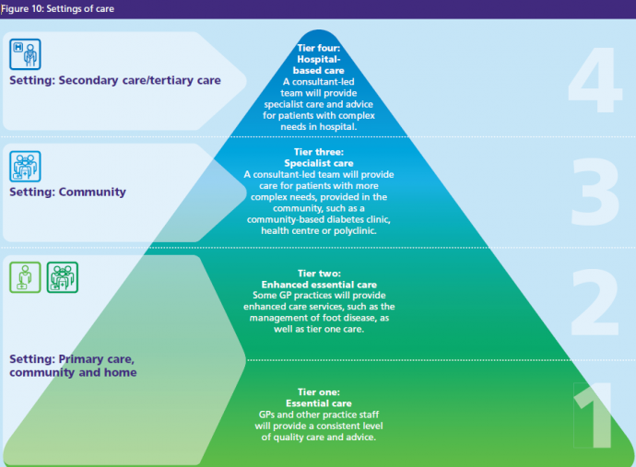
Notes:
https://www.royalfree.nhs.uk/services/services-a-z/diabetes-camden-ipu/our-model-of-care/

Slide 12

Notes:
https://www.gov.uk/government/publications/health-matters-preventing-type-2-diabetes/health-matters-preventing-type-2-diabetes

Slide 13
Case Lessons
Aligning incentives in value-based care
Definition of desired objectives / outcomes is crucial, and difficult
Health outcomes are multi-determined, so incentivizing health outcomes often increases complexity
Implementing incentive alignment around health outcomes:
Integration often lowers controllability (so does patient co-production)
Information: Policymakers, payers, and/or providers must invest in mapping from care processes to health outcomes.
Importance of your skills!
Transition to Section 2

Slide 14
 | Video Units | Weekly Activities
 | U1: Introduction | Course Week 1
 | U2: Decision Making
Section 1: Incentives | U3: Conflicts of Interest
 | U4: Value Based Incentives | Course Week 2 -Video Unit 4 -NHS case: Example operationalization
 | U5: Unintended Consequences | Course Week 3
Section 2: Information | U6: Variation in Spending
 | U7: ICER and QALY | Course Week 4
 | U8: Risk Adjustment
Section 3: Influence | U9: Patient Decision Making | Course Week 5
 | U10: Patient Adherence
 | U11: Patient Consumers
 | U12: Wrap | Course Week 6

Slide 15
 | Video Units | Weekly Activities
 | U1: Introduction | Course Week 1
 | U2: Decision Making
Section 1: Incentives | U3: Conflicts of Interest
 | U4: Value Based Incentives | Course Week 2
 | U5: Unintended Consequences | Course Week 3 Guest Speakers Team Assignment
Section 2: Information | U6: Variation in Spending
 | U7: ICER and QALY | Course Week 4
 | U8: Risk Adjustment
Section 3: Influence | U9: Patient Decision Making | Course Week 5
 | U10: Patient Adherence
 | U11: Patient Consumers
 | U12: Wrap | Course Week 6

Slide 16
DUMC Speakers
Wendy Webster, MA, MBA
Director of Clinical Operations
Duke Surgery
Duke Neurosurgery
Michael Lipkin, MD, MBA
Associate Professor Urologic Surgery
Associate Chief Medical Officer, Clinical Operations, Duke Private Diagnostic Clinics
Chief of the Clinics, Department of Surgery

Slide 17
Thanks! Questions?

